Slide 1
Practical Malware Analysis
Chapter 6: Recognizing C Code Constructs in Assembly
2025.01.21
Seonhye Park

Slide 2
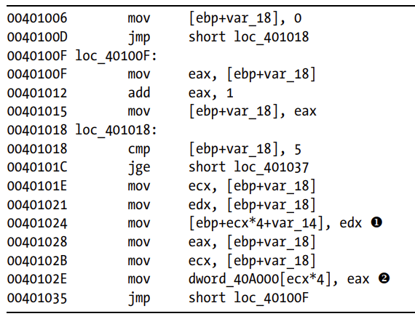
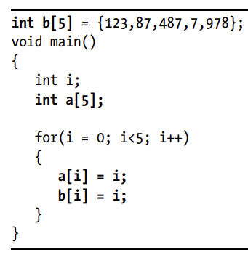
Motivation
How can we interpret assembly code?
We can translate assembly into a high-level language (e.g., C)
Our goal is not an exact reconstruction, but understanding the overall functionality
Notes:
remember that your goal iss to understand the overall functionality of a program, not to analyze every single instruction.

Slide 3
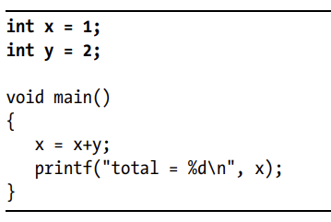
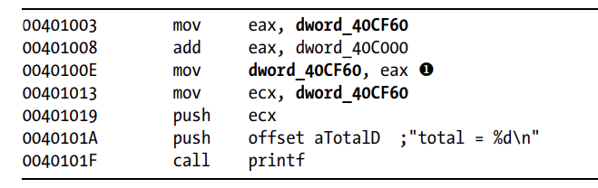
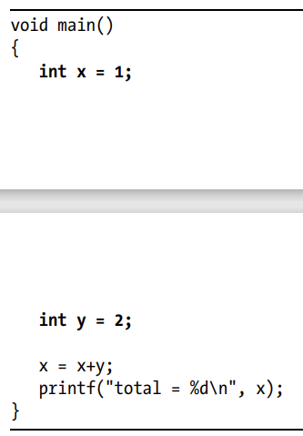
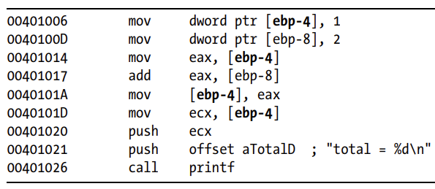
Global vs. Local Variables
memory location at 0X40CF60
Glabal variables
→ referenced by memory addresses
e.g., dword ptr [rip+2AF3h], dword_42AA0
stack address
Local variables
→ referenced by the stack addresses
e.g., [rbp+var_4], [rsp-8]

Slide 4
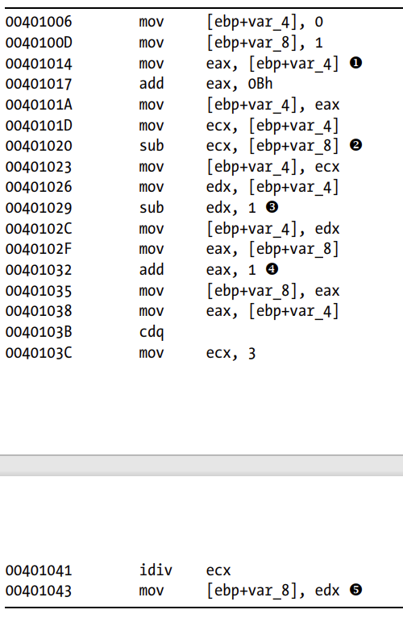
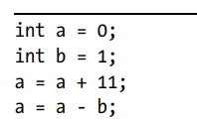
Disassembling Arithmetic Operations
a
b
→ EDX:EAX = sign-extended x
→ division: (EDX:EAX) / ECX
→ store EAX: quetient, EDX: remainder

Slide 5
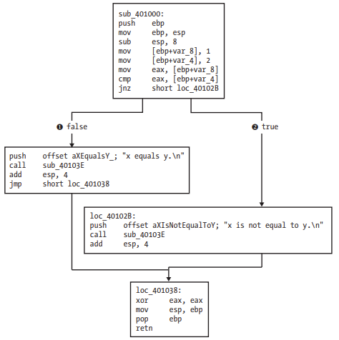
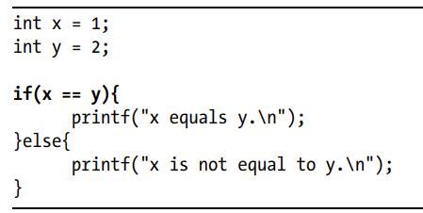
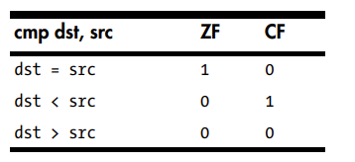
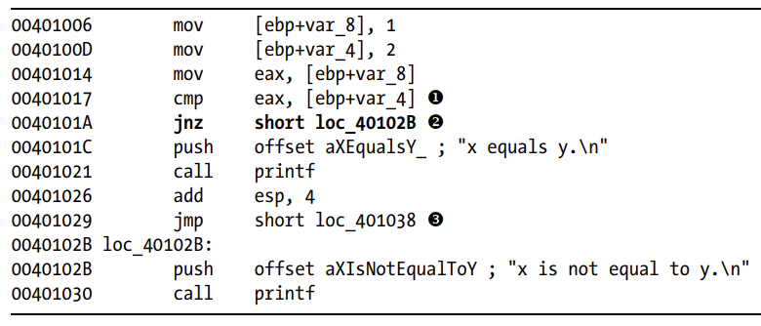
Recognizing if Statements
Disassembly graph from IDA-Pro
Jump if not 0 (ZF==0)

Slide 6
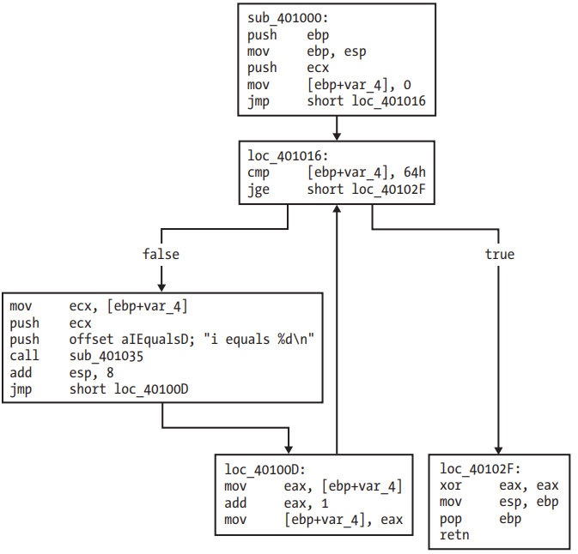
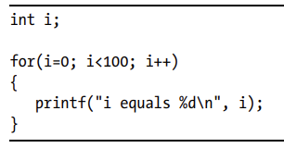
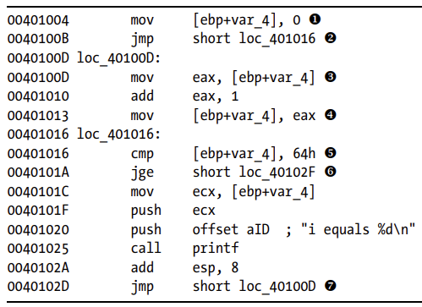
Recognizing Loops
Jump if >=

Slide 7
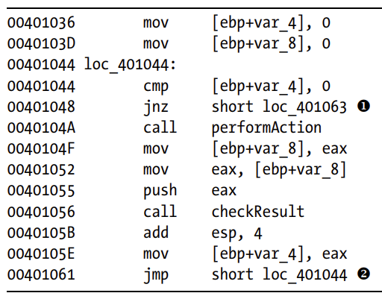
Quiz1: While loop
C codes
int...
Jump if not 0

Slide 8
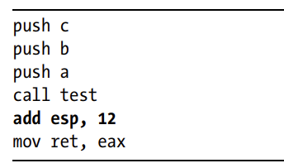
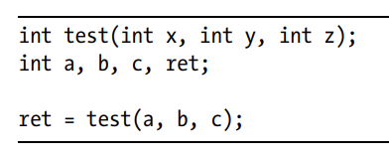
Understanding Function Call Conventions
the parameters are pushed onto the stack from right to left

Slide 9
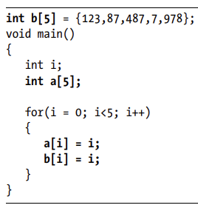
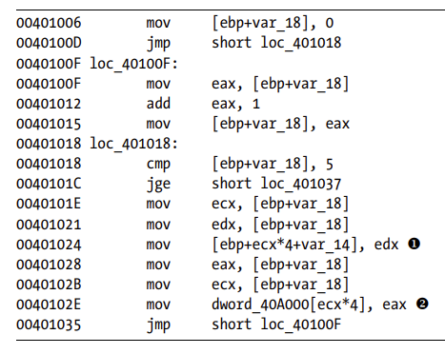
Disassembling Arrays
ebp+var_18
ebp+var_14
ebp+var_14+4
ebp+var_14+8
ebp+var_14+C
ebp+var_14+10
Stack
ebp-18
i
a[0]
a[1]
a[2]
a[3]
a[4]
40A000
40A004
40A008
40A00C
40A010
Memory
b[0]
b[1]
b[2]
b[3]
b[4]

Slide 10
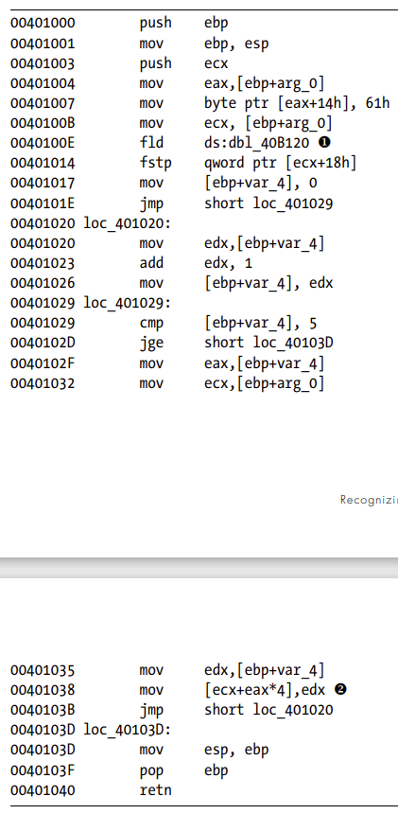
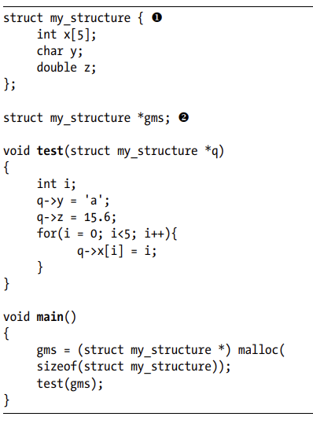
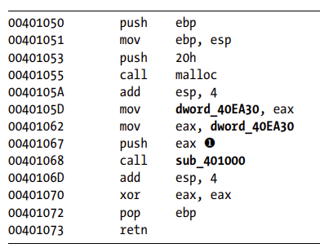
Identifying Structs
eax
eax + 4
eax + 8
eax + C
eax + 10
eax + 14
eax + 1C
eax + 20
0
1
2
Test
3
?
4
?
“a”
Double value
Main
The size of struct is 32
?
eax pointes returned memory address
?

Slide 11
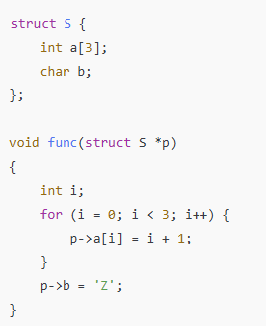
Quiz2
func proc near
push ebp
mov ebp, esp
sub esp, 4
mov [ebp+var_4], 0
jmp short loc_401020
loc_40100F:
mov eax, [ebp+var_4]
add eax, 1
mov [ebp+var_4], eax
loc_401020:
cmp [ebp+var_4], 3
jge short loc_40103A
mov ecx, [ebp+arg_0]
mov eax, [ebp+var_4]
mov edx, eax
add edx, 1
mov [ecx+eax*4], edx
jmp short loc_40100F
loc_40103A:
mov eax, [ebp+arg_0]
mov byte ptr [eax+0Ch], 5Ah
mov esp, ebp
pop ebp
retn
func endp
?
?

Slide 12
Q&A

Slide 13
Appendix: Jump Statements
 | When Flag = 1
ZF (Zero Flag) | Result == 0
CF (Carry Flag) | Unsigned overflow
SF (Sign Flag) | Result < 0
TF (Trap Flag) | Execute only one instruction at a time
 | Condition | Test
jmp | Jump | 1
je (jz) | Jump if 0 | ZF==1
jne (jnz) | Jump if not 0 | ZF==0
js | Jump if < | SF!=OF
jns | Jump if >= | SF==OF
jg | Jump if > | ZF==0 and SF=OF
jge | Jump if >= | SF==OF
jl | Jump if < | SF!=OF
jle | Jump if <= | ZF==1 or SF!=OF
ja | Jump if >= | CF==0 and ZF==0
jb | Jump if < | CF==1

